Slide 1
BATTLESHIP GAME
GROUP:
LIGHTNING TORPEDOS
MEMBERS:
AMJAD MALIK
ASADUJAMAN NUR

Slide 2

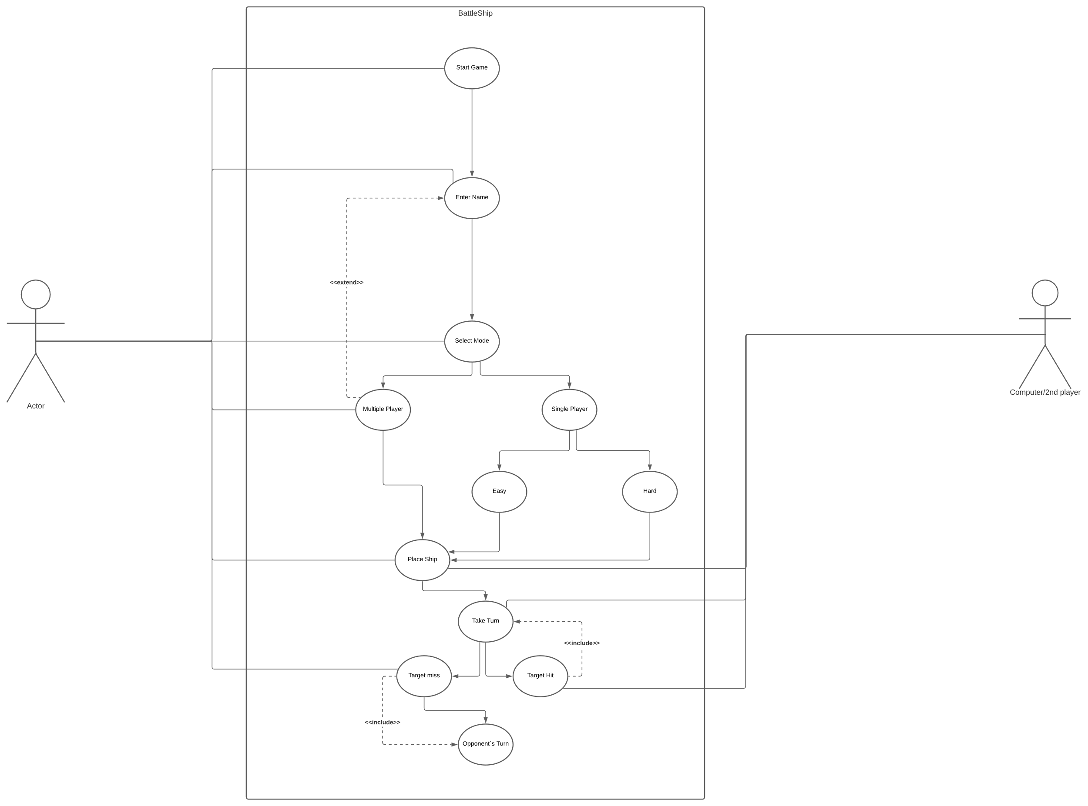
ACTIVITY DIAGRAM

Slide 3
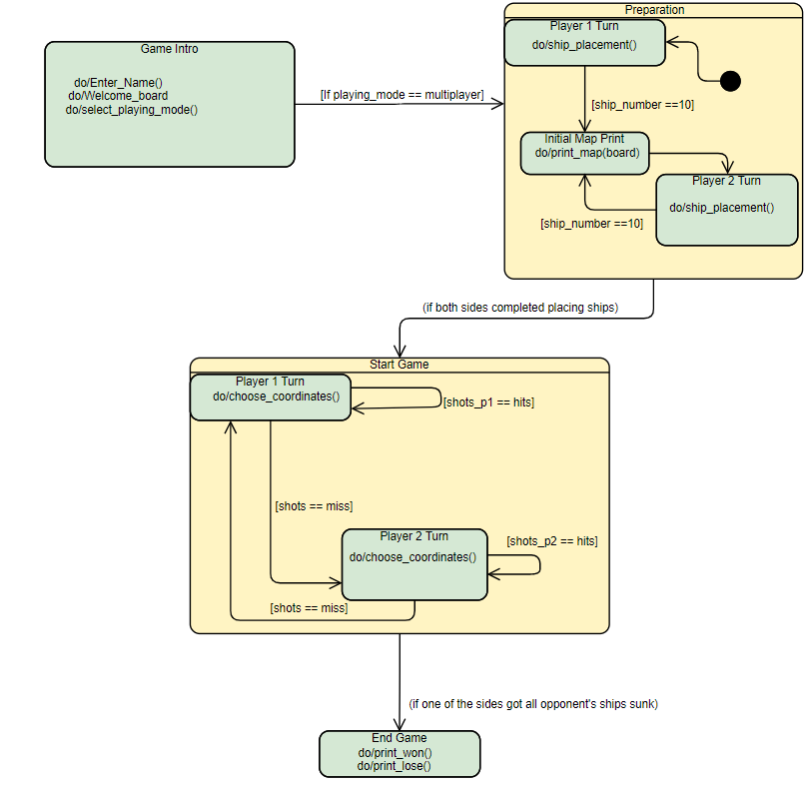
OVERALL GAME DIAGRAMS

Slide 4
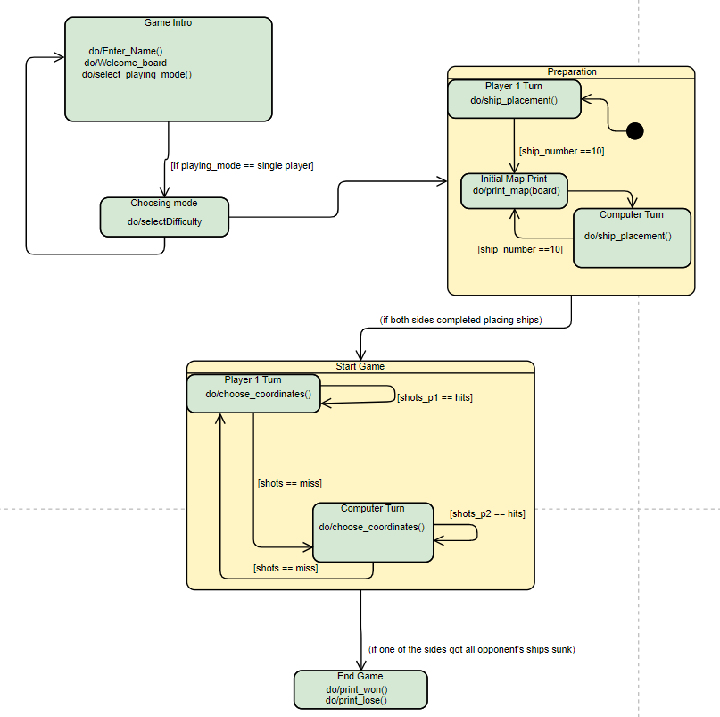

Slide 5
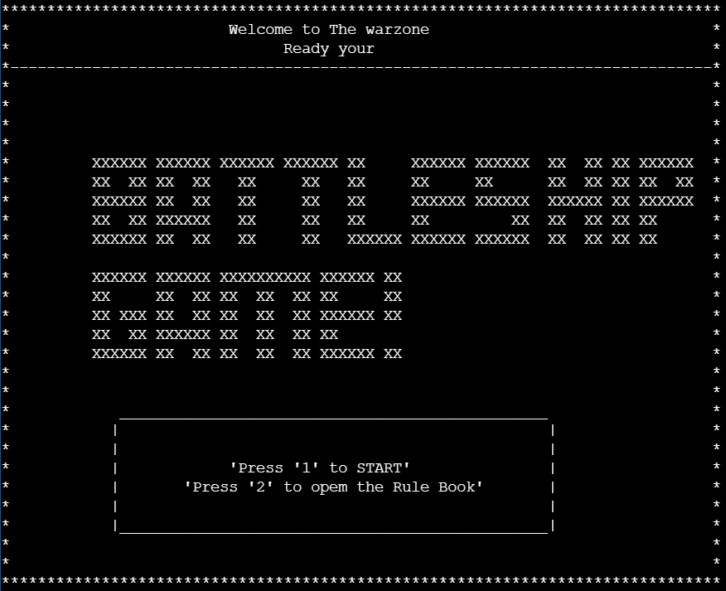
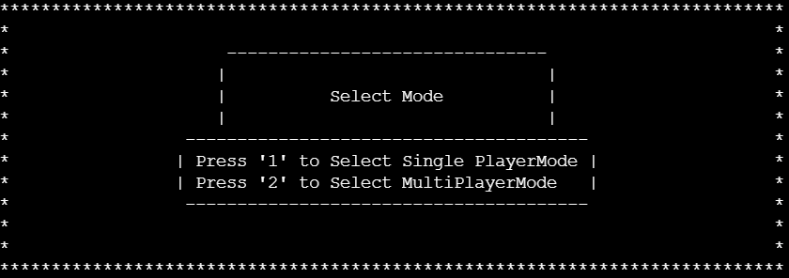
INTERFACES

Slide 6
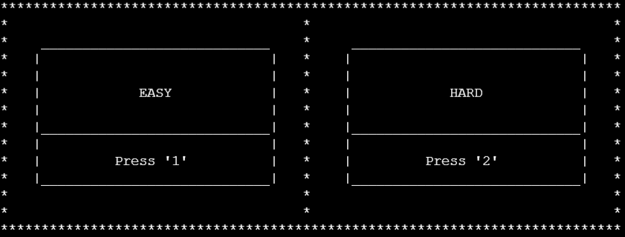
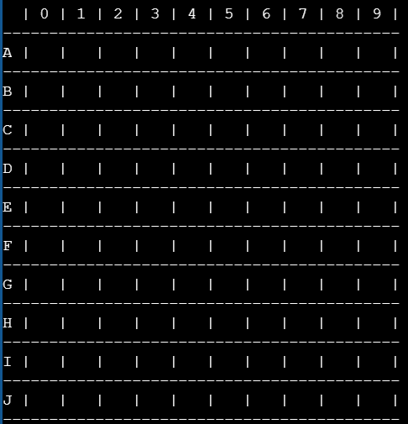
SELECT DIFFICULTY OPTION
FOR SINGLE PLAYER MODE
BOARD/MAP EXAMPLE

Slide 7
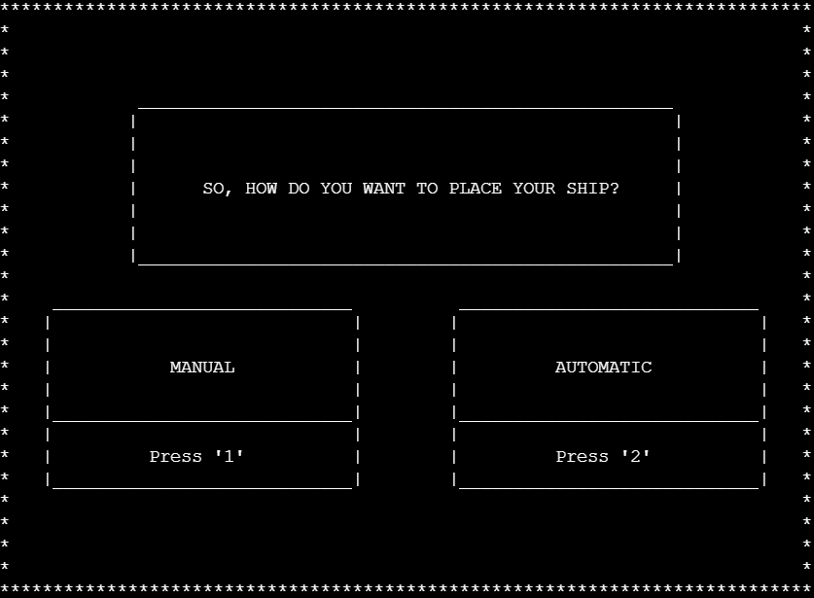
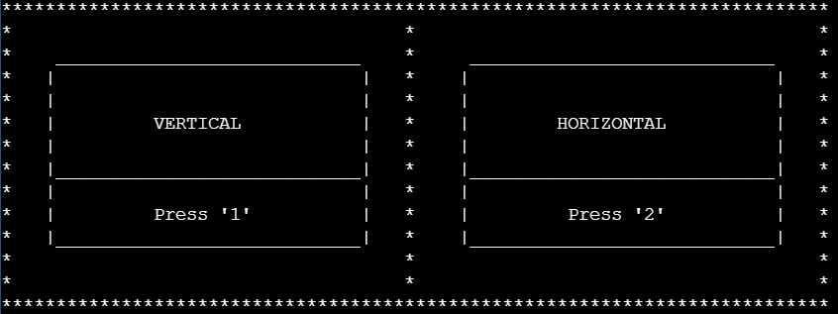
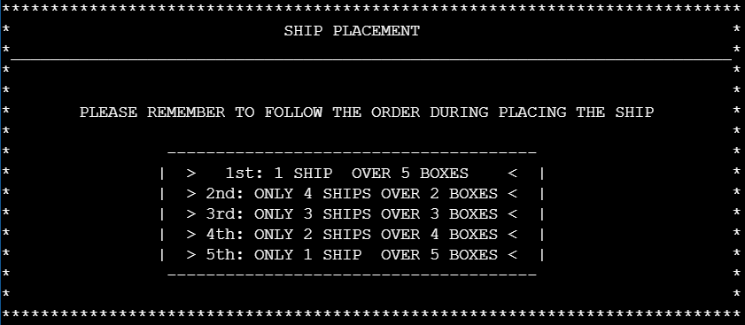
PLACING THE SHIPS

Slide 8
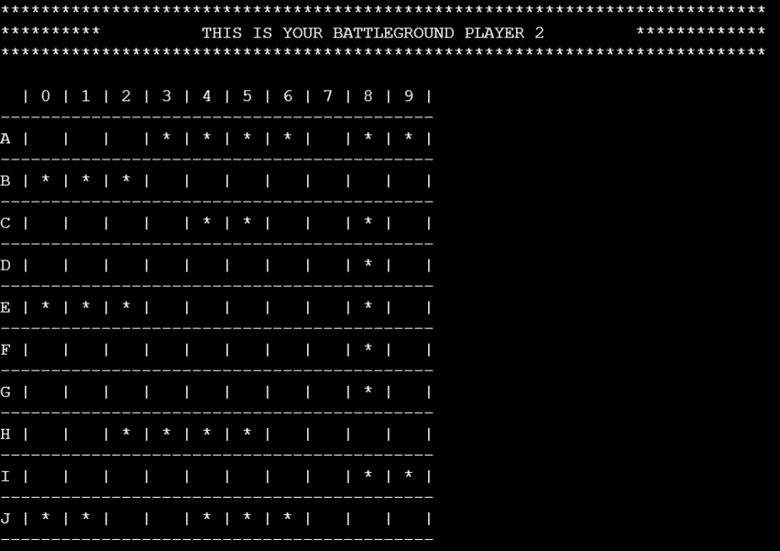
PLACING THE SHIPS AUTOMATICALLY

Slide 9
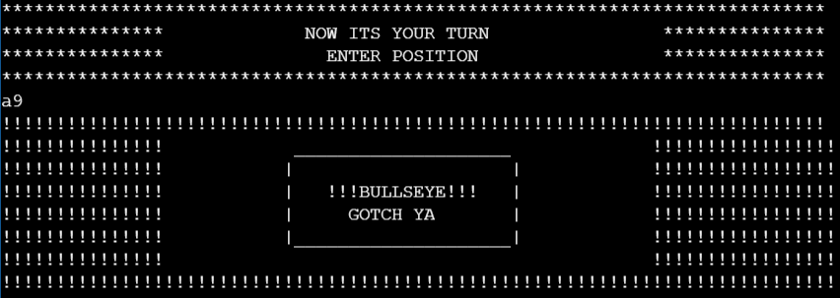


HITTING / MISSING THE TARGET

Slide 10
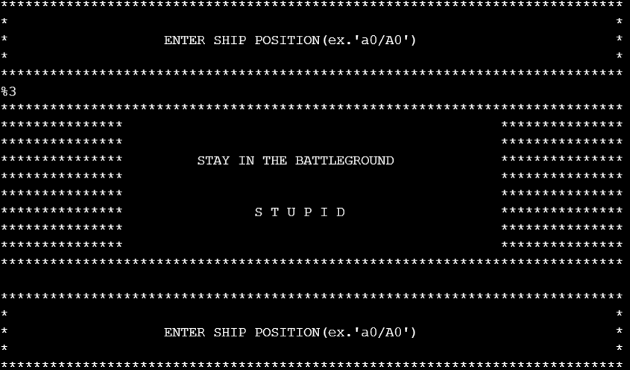

FAULT TOLERANCE

Slide 11
GAME SIMULATION AND THE CODING PARTS BEHIND IT

